Slide 1


Information for Everyone
A Supportive Information Ecosystem for Disadvantaged Groups
Mehmet Eren Ekşi
Yiğit Erel
Student ID: 2364932
Student ID: 2483739

Slide 2


The Challenge
The Barrier
The Solution
Navigating essential services (Health, Legal, Social) is often complex, text-heavy, and scattered across unoptimized digital systems.
A centralized, highly accessible mobile tool that simplifies critical data into a navigable, "one-tap" format for quick action.

Slide 3
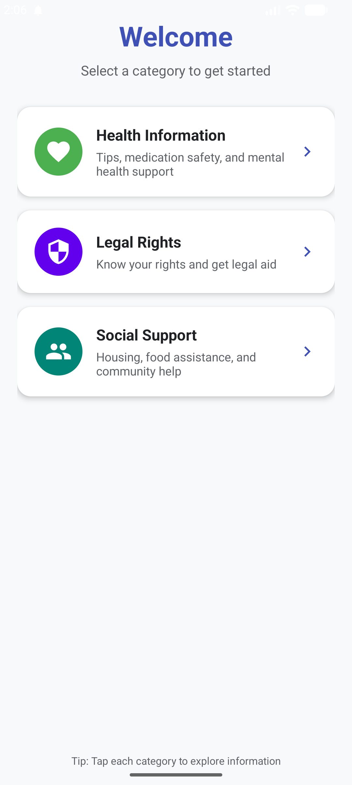


Who We Empower
Inclusive Digital Design
Our target group faces technological, cognitive, or socioeconomic barriers. They are the most in need but the least likely to navigate complex systems.
Full Accessibility Support
Zero-Cost Essential Guidance

Slide 4









Core App Features
Smart Curation
Real-Time Tips
One-Tap Help
Information divided into Health, Legal, and Social Support for intuitive discovery.
Live internet integration fetching daily life advice via the Advice Slip API.
Direct "Call 112" integration via Android Implicit Intents (ACTION_DIAL).
Background Engine
Material UI 3
Reliable Delivery
Background services ensuring users receive daily guidance notifications.
Optimized with large text, clean cards, and full Light/Dark mode support.
Boot receivers ensure the app's notification engine stays active after restarts.

Slide 5
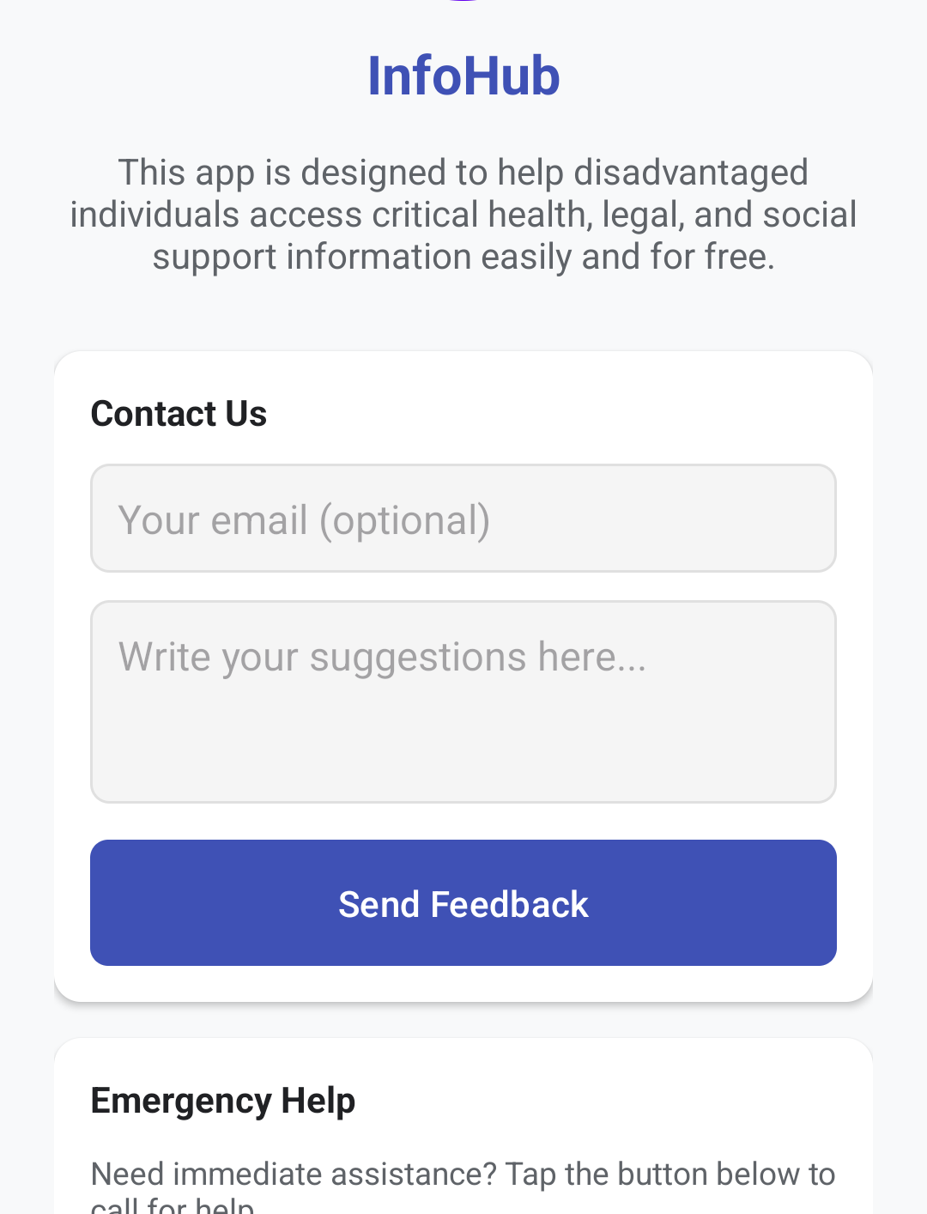
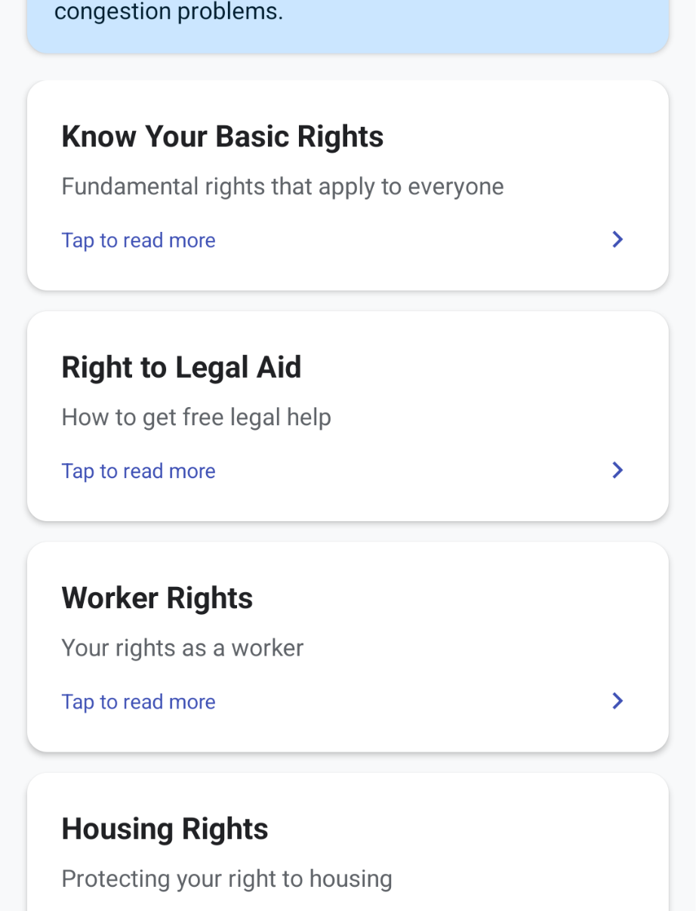
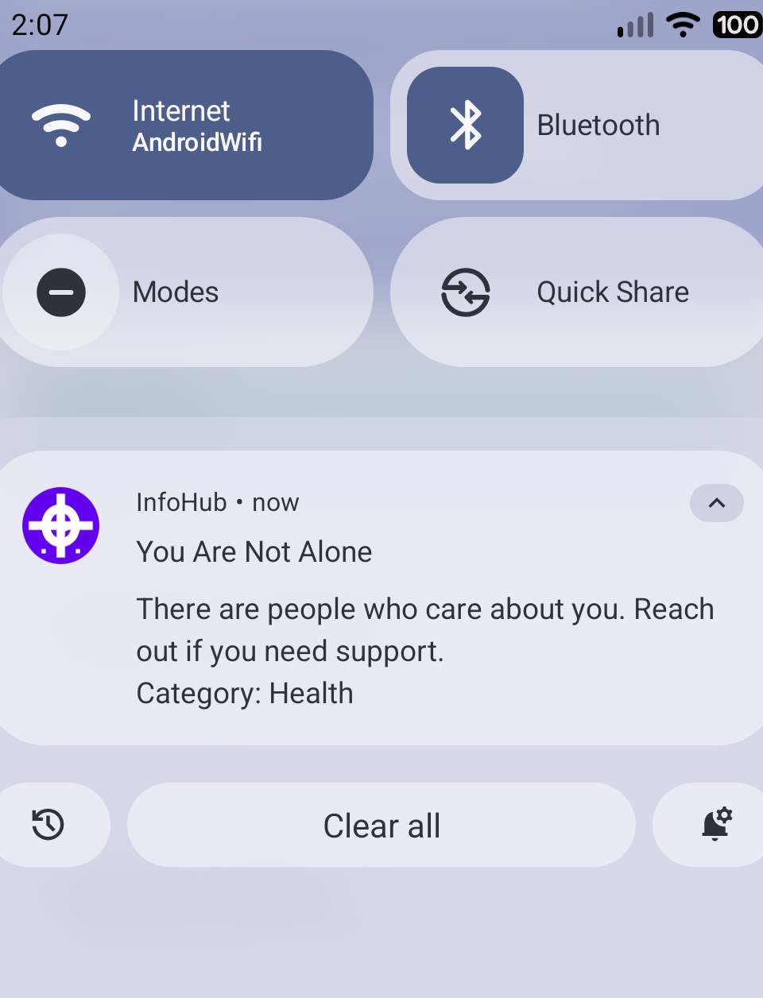
Interactive Interface
Emergency Contact
Example Menu
System Notification

Slide 6
Technical Architecture
Java MVC & OOP: Proper data encapsulation with InfoItem and Repository classes for scalable logic.
Asynchronous Networking: HttpRequestTask pulls JSON data from Advice Slip API without UI thread blocking.
Services & Broadcasts: Combined TipNotificationService with BootReceiver for system-level persistence.

Slide 7



Questions?
"Information for Everyone" – Bridging the digital gap through advanced Android development.
Mehmet Eren Ekşi & Yiğit Erel
CMP2004 Advanced Programming | 2025-2026 Spring

